Slide 1
Point of Sale System

Slide 2
The Team
Anthony Quigley (ajquigle@oakland.edu) - Computer Science
Jiann-Cherng (Mel) Chi (jchi@oakland.edu) - Computer Science
Mitchell Moore (mamoore4@oakland.edu) - Computer Science
Timothy Parzynski (tpparzyn@oakland.edu) - Information Technology

Slide 3
Current State (Database)
Amazon AWS - MySQL
Ports not available on Oakland Network
May have to work offsite more
Additional Backup - MySQL
Hosted on private server

Slide 4
Current State (Project Logistics)
GitHub
https://github.com/aQuigs/POS
Contains
Daily Documentation
Project Code
Software Requirement Specification Documentation Started

Slide 5
Current State (Programming)
MySQL Utility Classes
Connection
Select/Insert/Delete
Add/Drop Tables
Stored Procedures (Unsure if we need these yet)

Slide 6
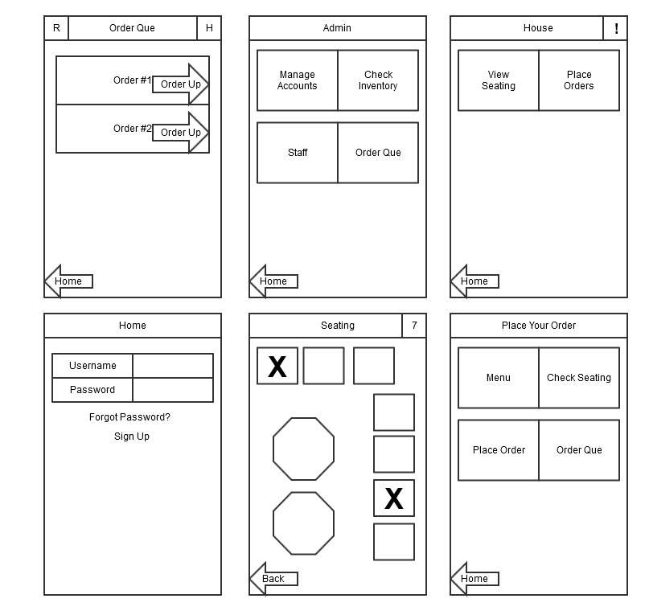
Interfaces
Basic Designs
Still working on a few other ones

Slide 7
Admin/Owner
add menu item
delete menu item
change menu item price
add user
remove user
get user list

Slide 8
Host(ess) and Waiter(ress)
Assign guests to open seats
Take orders
Get order notification when ready

Slide 9
Kitchen
See orders in the order it came in
Swipe to say the order is ready to notify the front of house
See statistics (average time per dish)
See expected inventory levels
Edit inventory levels when new shipment arrives

Slide 10
Consumer
Get Menu Details
Place Order
Place Order for Dine In
Check Valid Login
Pay for Meal
Get Order Status

Slide 11
Schedule
Date | Iteration | Goals
9/24/2015 | 1 | Basic Server Setup, Main Tables completed
10/1/2015 | 2 | Host(ess)/Waiter(ress) System Food Ordering System done Basic MySQL Utilities
10/8/2015 | 3 | Final Requirements and Bug Fix Week
10/15/2015 | 4 | Kitchen Interface Finished

Slide 12
Plan for this week
Basic Logins
Create basic tables
staff table: (user,pass,acc type,restaurant)
customer table: (user, password)
Menu (one per restaurant) (Name of Item, Price, Calories)
Orders (order count, restaurant ID, order id, user)
Order (item #, comment)
Continue on SRS
MySQL Utilities Class Worked

